Slide 1
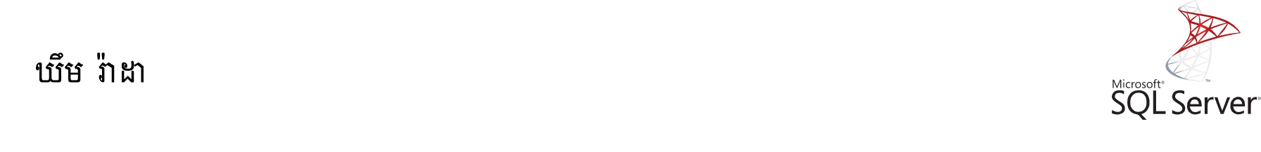
User-defined Functions
In this section, you will learn about SQL Server user-defined functions including scalar-valued functions which return a single value and table-valued function which return rows of data.

Slide 2
The SQL Server user-defined functions help you simplify your development by encapsulating complex business logic and make them available for reuse in every query.

Slide 3
SQL Server Scalar Functions
SQL Server scalar function takes one or more parameters and returns a single value.

Slide 4
The scalar functions help you simplify your code. For example, you may have a complex calculation that appears in many queries. Instead of including the formula in every query, you can create a scalar function that encapsulates the formula and uses it in each query.

Slide 5
Creating a scalar function:
To create a scalar function, you use the CREATE FUNCTION statement as follows:

Slide 6
CREATE FUNCTION [schema_name.]function_name (parameter_list)
RETURNS data_type AS
BEGIN
statements
RETURN value
END

Slide 7
First, specify the name of the function after the CREATE FUNCTION keywords. The schema name is optional. If you don’t explicitly specify it, SQL Server uses dbo by default.
Second, specify a list of parameters surrounded by parentheses after the function name.

Slide 8
Third, specify the data type of the return value in the RETURNS statement.
Finally, include a RETURN statement to return a value inside the body of the function.

Slide 9
The following example creates a function that calculates the net sales based on the quantity, list price, and discount:

Slide 10
CREATE FUNCTION sales.udfNetSale(@quantity INT,
@list_price DEC(10,2),@discount DEC(4,2))
RETURNS DEC(10,2)
AS
BEGIN
RETURN @quantity * @list_price * (1 - @discount);
END;

Slide 11
After creating the scalar function, you can find it under Programmability > Functions > Scalar-valued Functions as shown in the following picture:

Slide 12
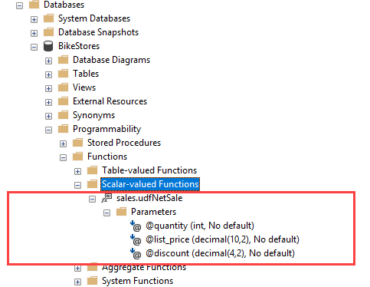

Slide 13

Calling a scalar function:
You call a scalar function like a built-in function. For example, the following statement demonstrates how to call the udfNetSale function:
SELECT
sales.udfNetSale(10,100,0.1) net_sale;

Slide 14
The following example illustrates how to use the sales.udfNetSale function to get the net sales of the sales orders in the order_items table:

Slide 15
SELECT order_id, SUM(sales.udfNetSale(quantity, list_price, discount)) net_amount
FROM sales.order_items
GROUP BY order_id
ORDER BY net_amount DESC;

Slide 16
Modifying a scalar function:
To modify a scalar function, you use the ALTER instead of the CREATE keyword. The rest statements remain the same:

Slide 17
ALTER FUNCTION [schema_name.]function_name (parameter_list)
RETURNs data_type AS
BEGIN
statements
RETURN value
END

Slide 18
Note that you can use the CREATE OR ALTER statement to create a user-defined function if it does not exist or to modify an existing scalar function:

Slide 19
CREATE OR ALTER FUNCTION [schema_name.]function_name (parameter_list)
RETURN data_type AS
BEGIN
statements
RETURN value
END

Slide 20
Removing a scalar function:
To remove an existing scalar function, you use the DROP FUNCTION statement:
DROP FUNCTION [schema_name.]function_name;

Slide 21
For example, to remove the sales.udfNetSale function, you use the following statement:
DROP FUNCTION sales.udfNetSale;0

Slide 22
Thanks

Slide 23
Exercise

